Slide 1
3D Classroom Simulation

Slide 2

INTRODUCTION
Simple Modelling of Classroom

Slide 3
OBJECTIVES
Familiarize with the Computer Graphics concepts
Implementation through programming.
OpenGL Knowledge
Group Work and Project Management

Slide 4
REQUIREMENTS
GLUT
C++
Visual Studio as IDE

Slide 5
IMPLEMENTATION
Header File
-Define Classes
Class
-Drawing Object on screen
Main
-Process Callback Functions

Slide 6
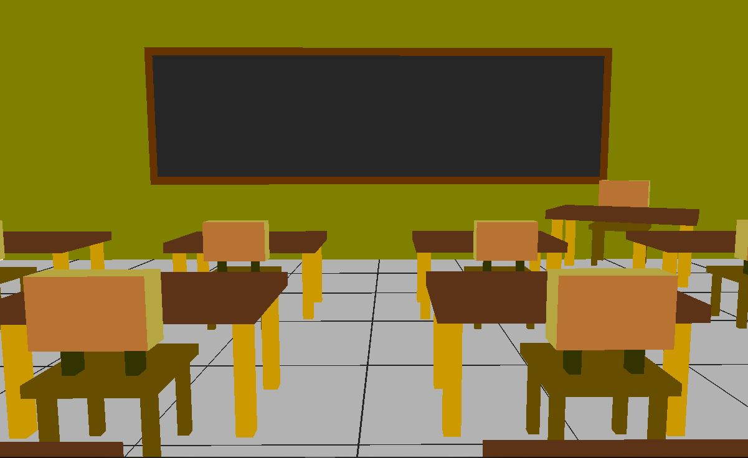
A Glimpse at the Environment

Slide 7
LIMITATION AND ENCHANCEMENT
Less Objects
Lighting Feature
Less realistic

Slide 8
CONCLUSION
Understanding Graphics
Hands-on experience on OpenGL
Management and Team Work.

Slide 9
Demo

